Slide 1
“Project for Preparedness for Oil-polluted Shoreline Clean-Up and Oiled Wildlife interventions 2 – POSOW 2”
A preparedness Project for European / Mediterranean Civil Protection.

Slide 2
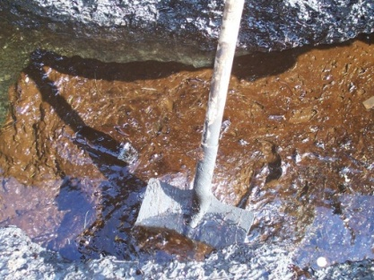
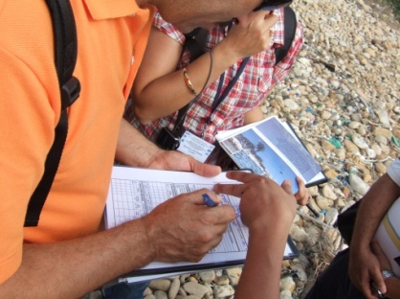
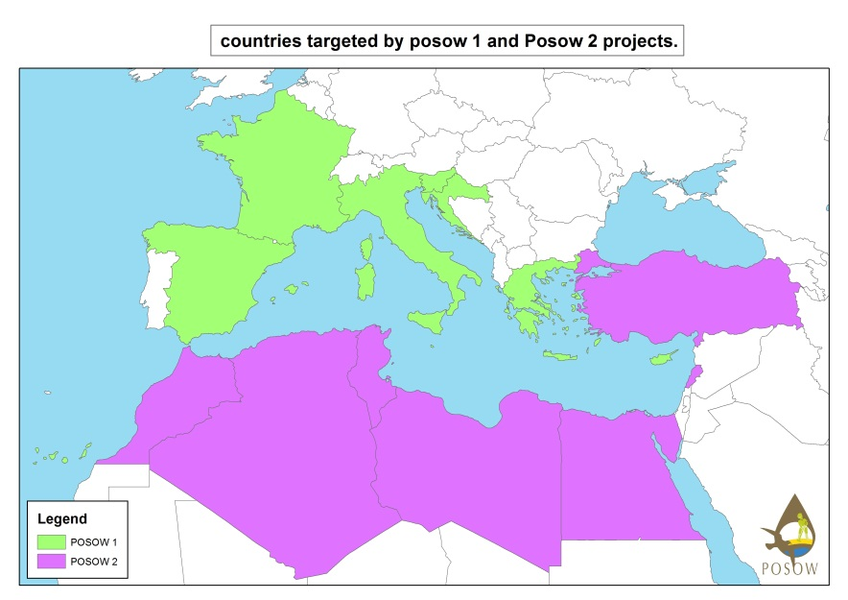
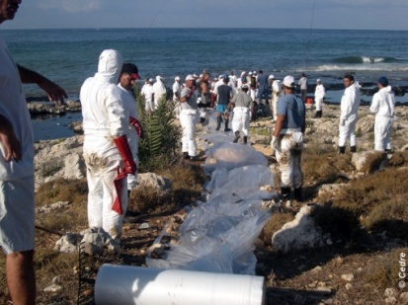
Key points
  Continuation of POSOW 1 (2012-2013)
  24 months’ duration
  5 partners
  Target: National and local authorities & NGOs
  Total budget : 602,717 €
  EC Contribution (70,96%): 427,658 €
  7 Southern Mediterranean countries

Slide 3





Partners & beneficiaries
COORDINATION
PARTNERS
DG-MARINWA
BENEFICIARIES
National Civil Protection
Local communities
NGOs
From:
Algeria, Egypt, Lebanon, Libya,
Morocco, Tunisia, Turkey
VOLUNTEERS
Notes:
Partners of the project are structures with solid experience in the fields of civil protection & marine pollution
Beneficiaries of the project are operators (professionals or volunteers)

Slide 4
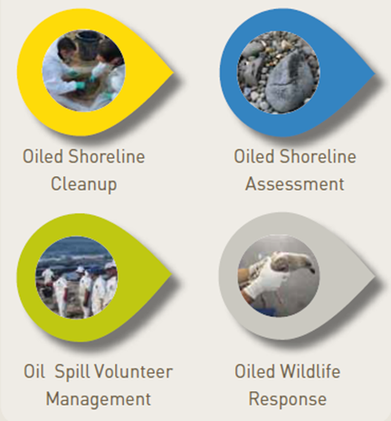
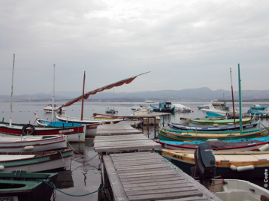
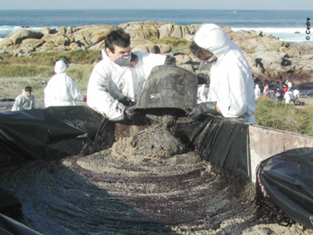
Objectives
Establishment of a regional cooperation synergy, enhancement of response capacities of volunteers from civil protection services, municipalities and NGOs.
1.
Extension and dissemination of POSOW 1 outputs and benefits to Southern Mediterranean countries
2.
Development and provision of two new Training Material Packages
Local fishermen assistance and the use of small vessels of opportunity
Waste management

Slide 5

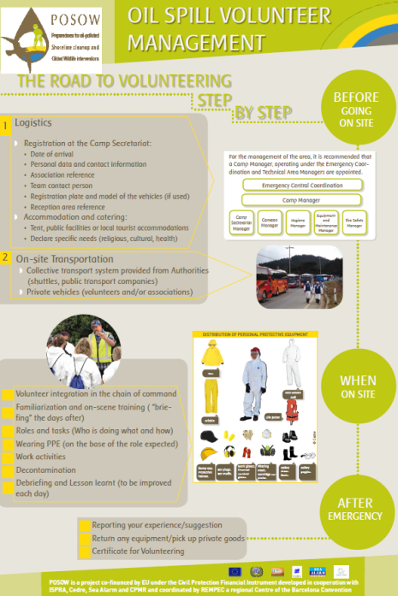
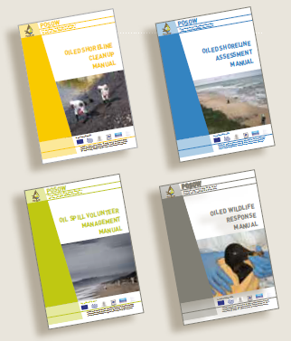
Deliverables (1/2)
Training Material Package:
PowerPoint Presentations
Instructor Manuals
Manuals
Posters

Slide 6
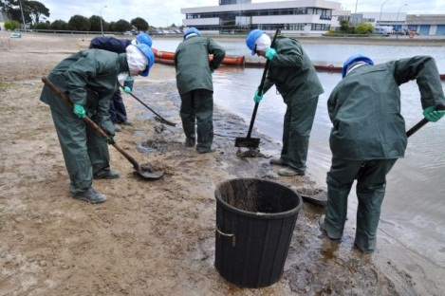
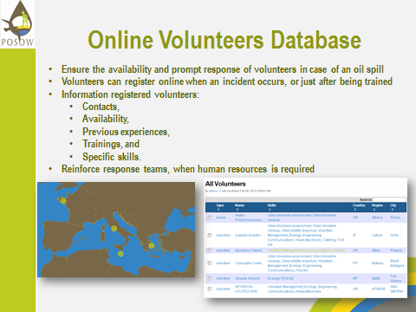
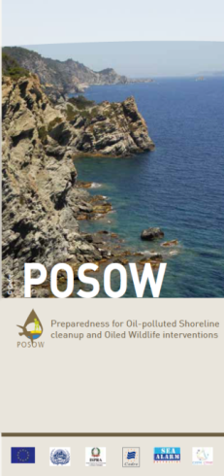
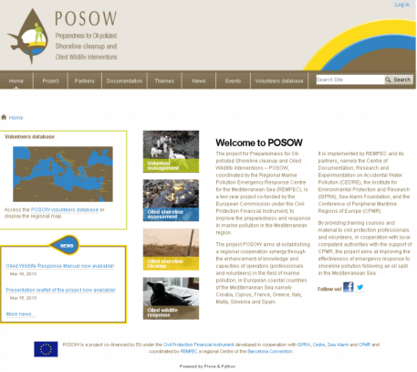
Deliverables (2/2)
Capacity building:
2 train the trainers courses
7 National volunteer training courses
Identification and follow-up of trained people:
updating the volunteer database
Information dissemination:
Website, brochure, movie
Practical exercise during Posow 1 training course

Slide 7
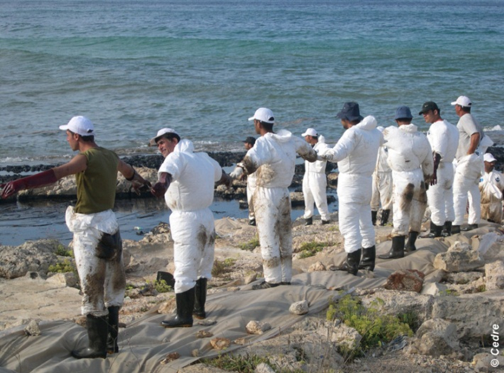
Training target audience
Training the trainers courses:
Local authorities
Local representative of Civil Protection
Local NGOs
…to become local instructors
  National volunteer training courses
  …to establish a pool of volunteers

Slide 8
Key dates

Slide 9
Follow-up
Periodic refreshment courses
Volunteers Database
Continuous availability of material
Extension of the project to other countries or other topics

Slide 10

More Information on
www.posow.org

